Slide 1
THE PULSATION OF THE COMMONS, THE FORGOTTEN
THIRD INSTITUTION IN HUMAN HISTORY, AND ITS POTENTIAL
ROLE IN THE NEXT CIVILIZATIONAL TRANSITION
Michel Bauwens
Global Chinese Commons research coordinator
Founder of the P2P Foundation
(currently working for the Civilization Research Institute) https://wiki.p2pfoundation.net
IBHA Conference, 2023: Big History and Global Evolution ; Moscow, October 24–26, 2023

Slide 2
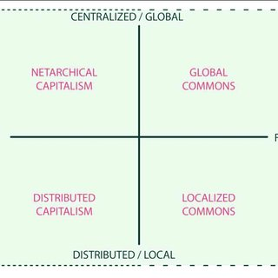
The four emerging economic models in the planetary networked cosmo-local economy

Slide 3
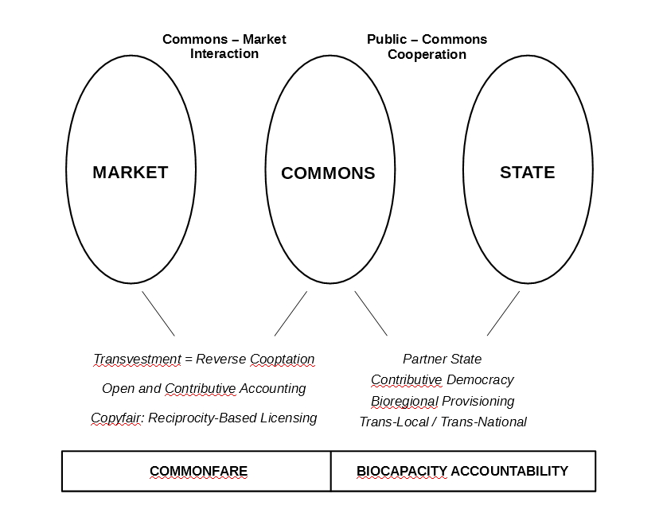
The contributory economy and society is not a binary, but a triarchical value system, centered around the commons, not commodity production

Slide 4
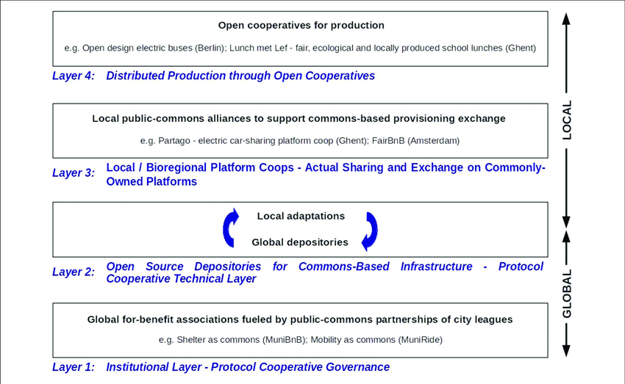
The partner state model fosters public Policies in favor of commons-centric territorial development

Slide 5
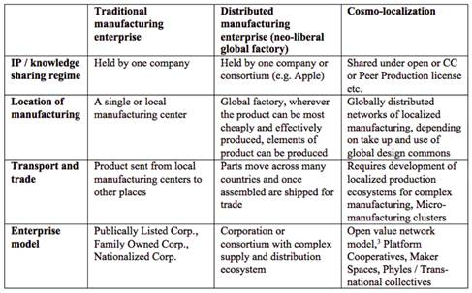
The Cosmo-Local Model: everything that is heavy is local, everything light is global and shared

Slide 6
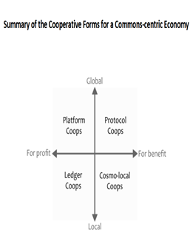
Review of post-capitalist attempts to create more resilient ecosystems

Slide 7
Comparing commons-based and propertarian based tech design
LEDGER PROJECTS:
LIBERTARIAN | vs. | COMMONS-BASED
Examples:
Bitcoin, |  | Holochain, Faircoin, ECSA, Ethereum Public Goods, Gitcoin
Principles:
Commodity-Based |  | Mutual Credit, Contribution-Based
Tokens and Cryptocurrencies |  | and Asset-Backed Tokens
Competitive Games |  | Cooperative Games
Smart Contracts |  | Ostrom Contracts
(individual to individual) |  | (social contracts and charters)
Oligarchic Proofs of Consensus |  | Distributed and Contributory Proofs
(one dollar, one vote)
One World Ledger to Rule Them All |  | Interoperable P2P Ledger Systems
Ethereum |  | Holochain
Market Value |  | Value Sovereignty
Extractive Ecosystems |  | Generative, Nature-Friendly Ecosystems
Profit-Driven |  | Impact, Purpose, For-Benefit Driven
Trustless |  | Trustful (Web of Trust)

Slide 8
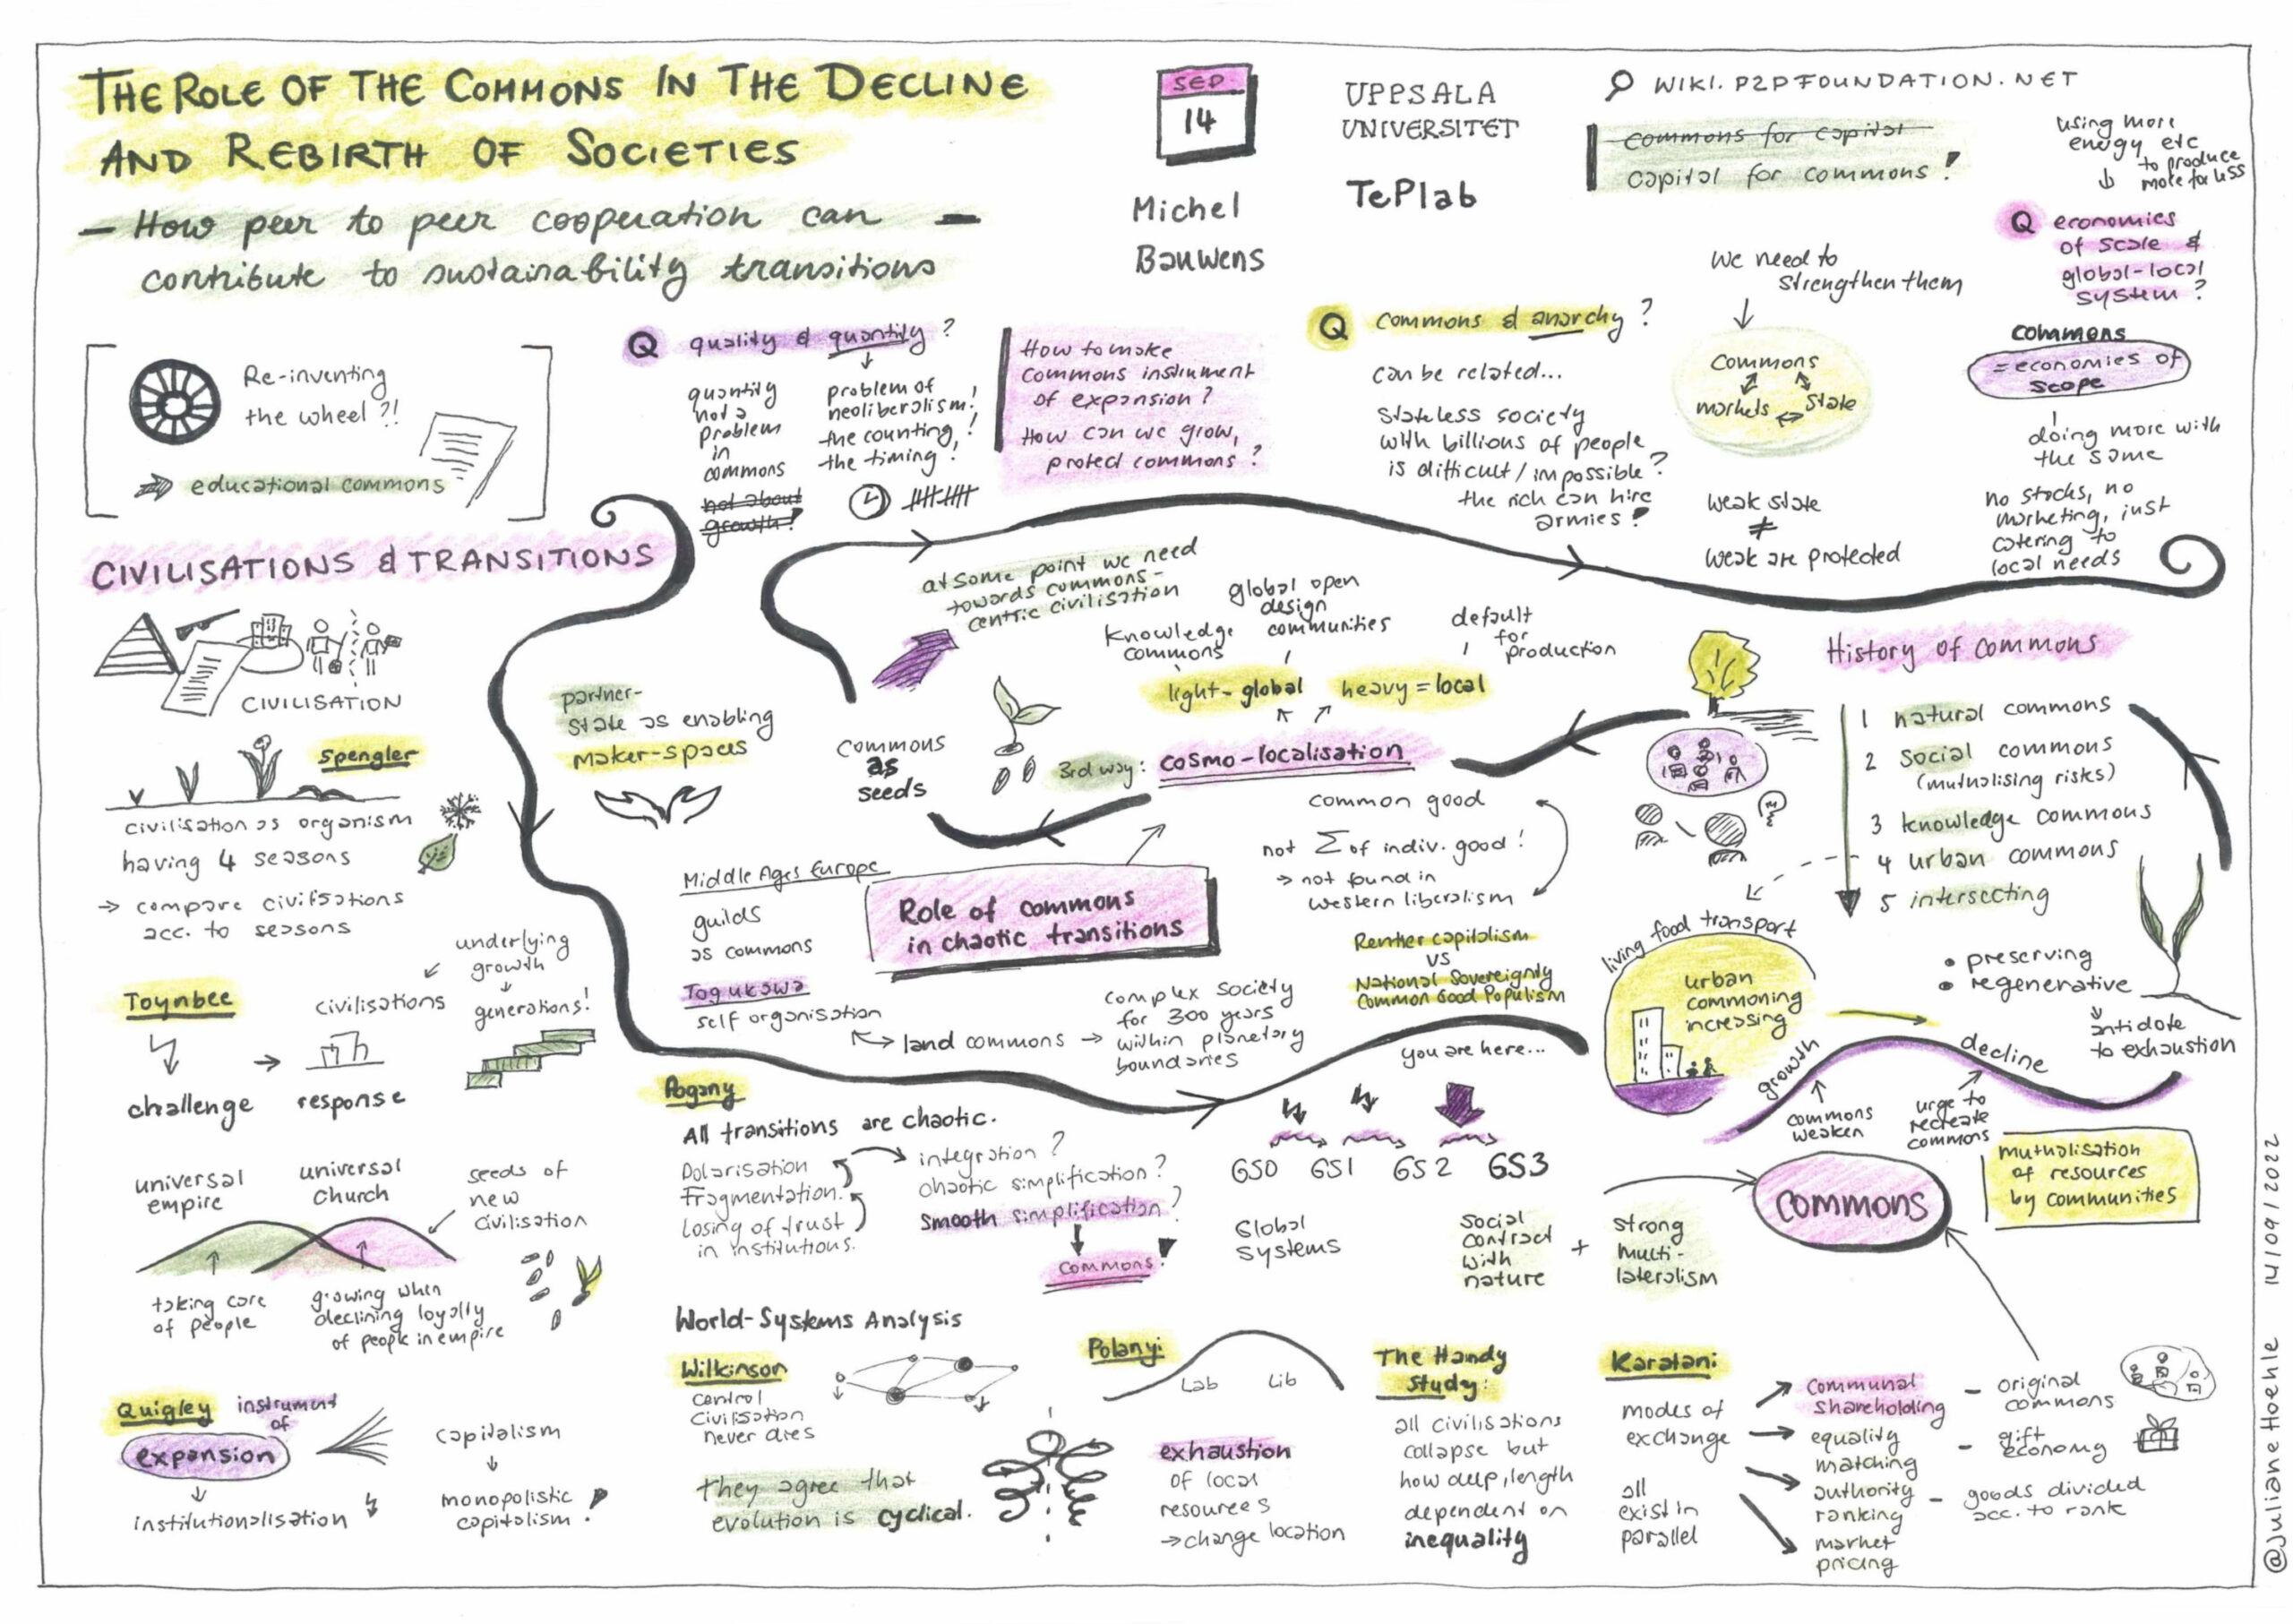
The pulsation of the commons in world history: towards Magisteria of the Commons

