Slide 1
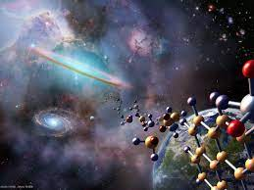
Chemical Evolution in Big History
Leonid E. Grinin
President of the Eurasian Center for Big History & System Forecasting, Russian Academy of Sciences.
Anton L. Grinin
Research Fellow, Lomonosov Moscow State University, Russia

Slide 2
Difficult question: Why is there so little research on chemical evolution in Big History?
Perhaps, no one knows the answer. We will return to it a bit later.
Why considering the chemical line of Big History is so important?
to enrich our ideas about the general course of Big History;
to better understand the processes and mechanisms of the development of complexity.
one can hardly grasp the mystery of the origin of life and the development of life in the early periods without it.
Big History and Chemical Evolution

Slide 3
What is chemical evolution?
The major events of pre-chemical evolution:
formation of the first hydrogen and helium atoms.
accumulation of heavy element atoms.
However, the formation of atoms cannot be considered yet as a chemical evolution in the full sense of the word.
Chemical evolution is the emergence and development of different and more complex types of molecules and substances.
Therefore, such an evolution could hardly begin in a very hot universe, nor could it take place in the depths of stars.

Slide 4
Conditions for chemical evolution
Chemical reactions:
can occur when the temperature drops to 5 thousand degrees, but actually the most favourable condition for them is at relatively low plus temperatures;
take place constantly in space, even at deep sub-zero temperatures;
should be even more active within the framework of evolution of planets and other bodies (including comets).
Some chemical compounds could only be formed as stars collapse or on the surface of cooling stars.

Slide 5
Chemical evolution as a peripheral and parallel line of Big History
Some important conclusions on the chemical evolution:
It could only begin after the Universe had cooled down.
It always evolved not in the main sequence of the Universe, that is, not in stars and galaxies.
It evolved at the periphery in gas and dust clouds and on peripheral celestial bodies, especially on planets.
For many billions of years, the ‘achievements’ of chemical evolution were, in a way, imperceptible.

Slide 6
Insufficient research on chemical evolution in Big History. What are the reasons?
The parallel development of chemical evolution within Big History might be one of the main reasons.
Its co-evolution with geological and biological evolution is the second reason.
The third reason is that we know very little about the abiogenic chemical evolution.
However, this in no way diminishes the role of chemical evolution.
On the contrary, it makes its study really relevant.

Slide 7
Chemical evolution. Beginning
The chemical evolution began in the first millions of years after the Big Bang, in gaseous hydrogen-helium clouds where the first molecules were formed.
Thus, chemical evolution proceeded in parallel with the star-galaxy evolution.
It is well known that in clouds, on planets, in comets and meteorites etc. there are many dozens of different non-inorganic and organic substances, including water, alcohols, acids, monosaccharides, and even amino acids (glycine).

Slide 8
Chemical evolution and exoplanets
We do not know when the first planets formed.
But with their emergence, the rate of chemical evolution increased considerably.
It happened due to the variety of chemical processes on the planets.
The important advantage was the different conditions existing on planets, including gaseous and liquid media.

Slide 9
Periodization of chemical evolution
Stages of chemical evolution before social phase
1) the formation of atoms of the first elements (hydrogen and helium);
2) the formation of atoms of heavier elements up to iron;
3) the formation of atoms of elements heavier than iron;
4) the formation of simple compounds (inorganic and organic).
However, the second and third stages could take place in parallel with the fourth one, but in different environments (in stars, while the fourth one – in less hot environments).

Slide 10
Periodization of chemical evolution
Stages of chemical evolution before the origin of life
5) the formation of compounds associated with minerals on planets;
6) synthesis of more complex organic formations, like nucleotides (on the Earth);
7) synthesis of more complex organic substances and polymers, including proteins, not yet capable of replication;
8) synthesis of replicators and substances associated with the origin of life.

Slide 11
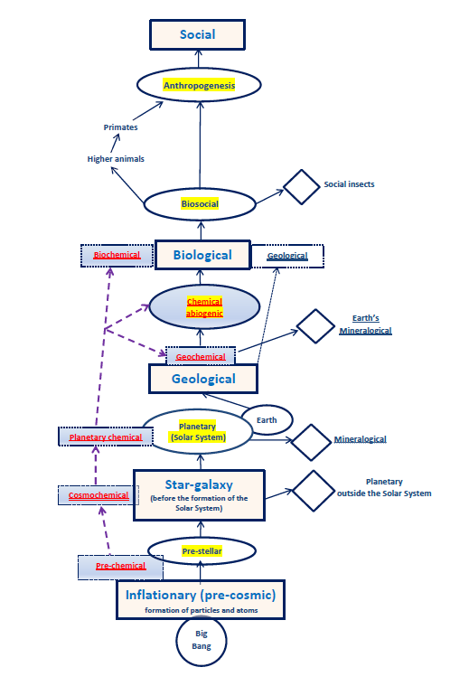
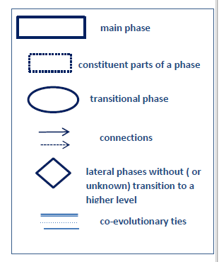
Phases of Big History and
Chemical Evolution

Slide 12
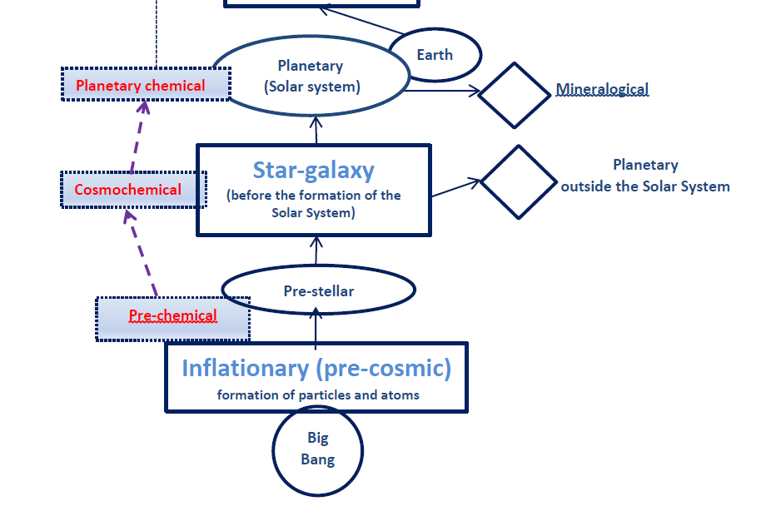
Chemical evolution in co-evolution

Slide 13
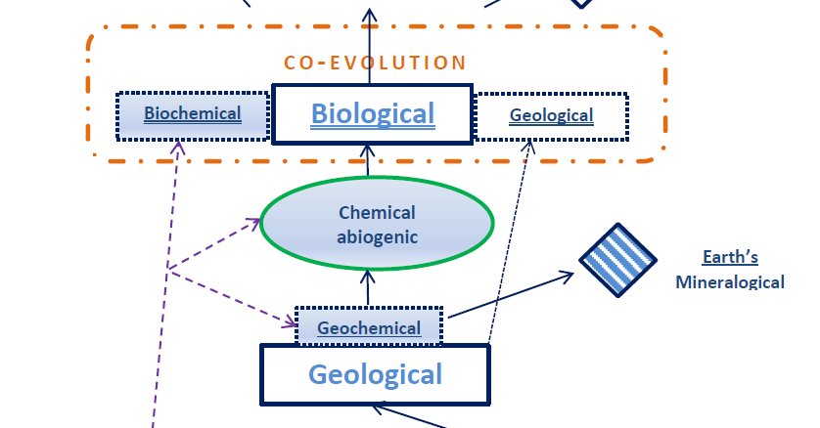
Chemical evolution in co-evolution

Slide 14
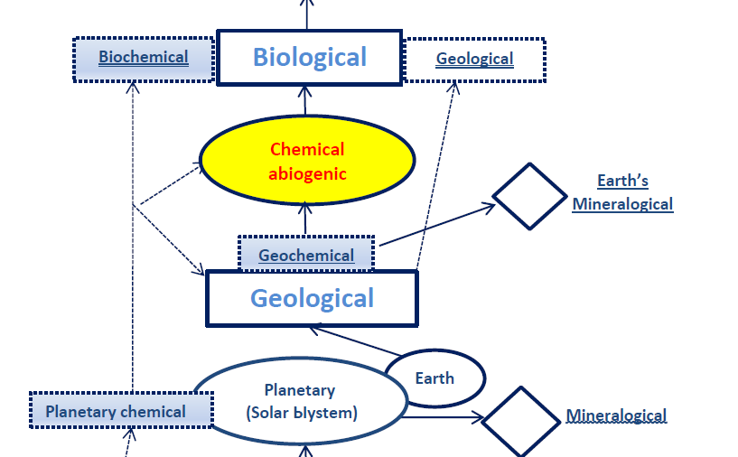
Chemical evolution in the centre of Big History

Slide 15
Evolutionary hypotheses about the origin of life
Strengths and weaknesses of evolutionary hypotheses
There are various hypotheses about the abiogenic chemical evolution and emergence of life including so-called the RNA world.
Progress has been made in many respects.
However, so far none of them seems entirely satisfactory due to the extreme complexity of the problem.
The weaknesses of these approaches are the following:
They deliberately or involuntarily reduce evolution to one of its lines.
They take one evolutionary mechanism as the main one in all cases.
The achievements of later periods, already related to the biological phase, are extrapolated to the abiogenic phase.

Slide 16
Multilinear chemical evolution and evolutionary breakthrough
Our evolutionary approach implies that:
the possibility of a major breakthrough exists only if there are a number of different development lines and ways.
each of these lines usually develops a single innovation.
these lines compete and complement each other.
Somehow the innovations of different lines add up to a fundamentally new system, which can up to a new level of complexity.
Systems do not emerge in the mature form, which usually require several transformations, including cycles of destruction and re-forming.
So primary systems as a rule look archaic and are unlikely to survive.

Slide 17
The first pre-living systems
(the so-called protobionts)
What were the first pre-living systems like?
The first pre-living systems (or protobionts) should not be considered as direct ancestors of the first living organisms.
They were only analogues of the first living organisms.
These analogues were already comparable to the most primitive living systems in terms of a number of functions;
but in general they were organized differently (it is now extremely difficult to say how exactly).

Slide 18
Abiogenic evolution
The evolutionary directions of abiogenic organic substances :
a) complication of chemical compounds and structures;
b) increase in energy output;
c) increase of reaction rate;
d) selection of compounds according to certain parameters;
e) concentration of substances;
f) the ability of proto-organisms to expand and grow quantitatively;
g) the selectivity and recognition of some substances by others, according to the important evolutionary pattern for self and non-self discrimination.

Slide 19
Abiogenic evolution and pre-adaptations
The most important pre-adaptations
for the start of biological evolution
creation of a system isolated from the external environment, in which constant chemical and biochemical reactions could take place;
constant maintaining of conditions, concentrations, energy balance, of the desired rate of reactions within this isolated environment;
effective responses to external conditions and stimuli;
replication (i.e., the ability to reproduce);

Slide 20
Abiogenic evolution and pre-adaptations
The most important pre-adaptations
for the start of biological evolution
preservation without major distortions of the initial code;
management of complex chemical processes through the use of increasingly advanced catalysts and substances,
autocatalysis and the ability to self-assemble.
These breakthroughs and pre-adaptations laid the foundations for biochemical metabolism and synthesis.
Especially important were the ability to store energy, to speed up reactions and to increase the concentration of a substance.

Slide 21
Along with these breakthroughs, a new type of information (chemical and biochemical) emerged.
They reached a very significant development later in biological evolution
Different achievements could not combine immediately and simultaneously.
They combined much later when the basic mechanisms of life and the living cell were formed.
Abiogenic evolution and
pre-adaptations

Slide 22
Abiogenic evolution and the ability to accumulate energy
The primary conditions after the origin of the Earth were unique but they provided the most important transition to the emergence of pre-life and later the origin of life.
Will these unique conditions ever be precisely known? Probably, they won’t.
But in any case, there must have been an abundance of available energy.
The fundamental difference between abiogenic chemical evolution and the previous stages of evolution - the ability to store energy by chemical transformation during a system’s lifespan and to use it for its own benefits.

Slide 23
Abiotic chemical evolution in co-evolution
At first, the abiogenic organic chemical evolution was only lateral and marginal in the general flow of inorganic chemical evolution.
Then, it advanced in a complex co-evolutionary movement to a new level of evolution, i.e., to life.
Abiogenic chemical evolution was involved in a whole bundle of evolutionary directions: geological, mineralogical, and geochemical.
In particular, one of the most important directions of chemical evolution was the integration of protobionts into geochemical processes, such as sulphur springs, and the development of the ability to use these processes for one's own benefit.
As a result, the abiotic chemical evolution gradually gained momentum.

Slide 24
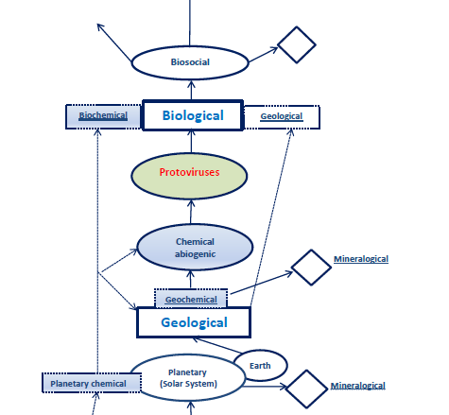
Protoviruses as a transitional phase of
Big History

Slide 25
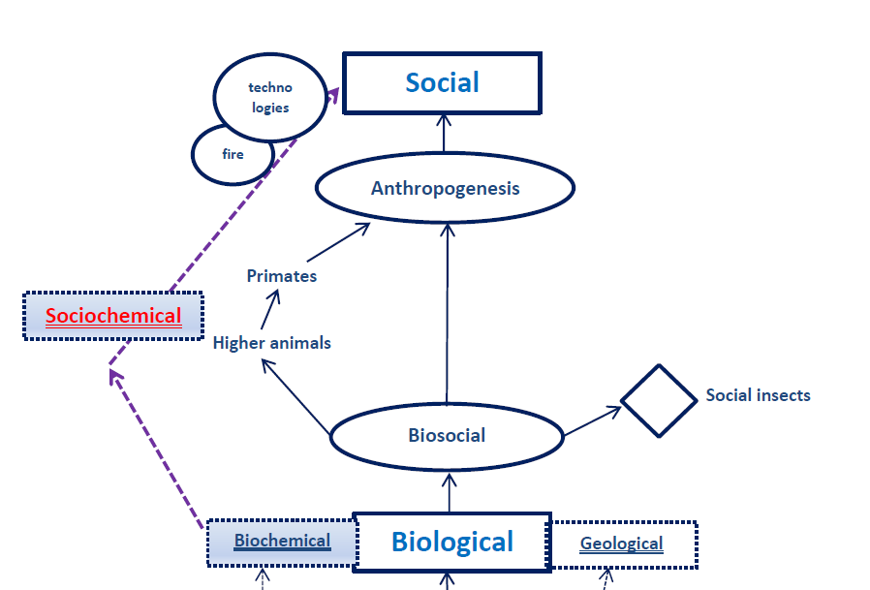
Sociochemical evolution

Slide 26


Thank you for your attention!

