Slide 1
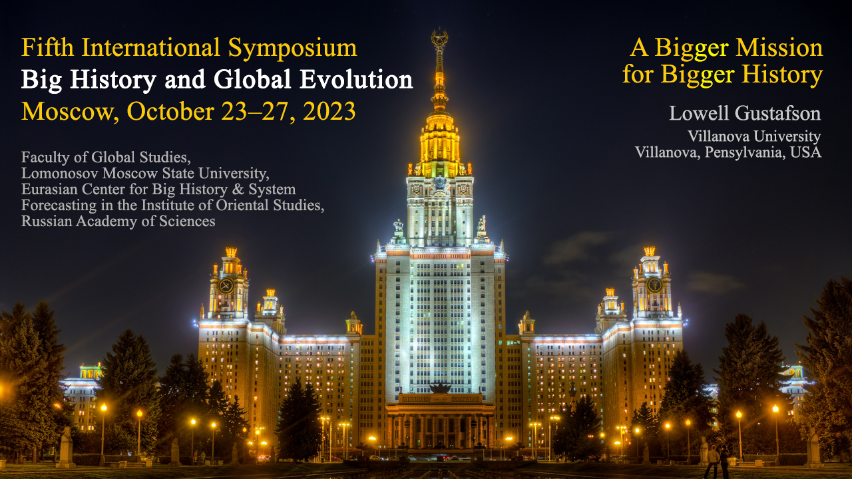

Slide 2
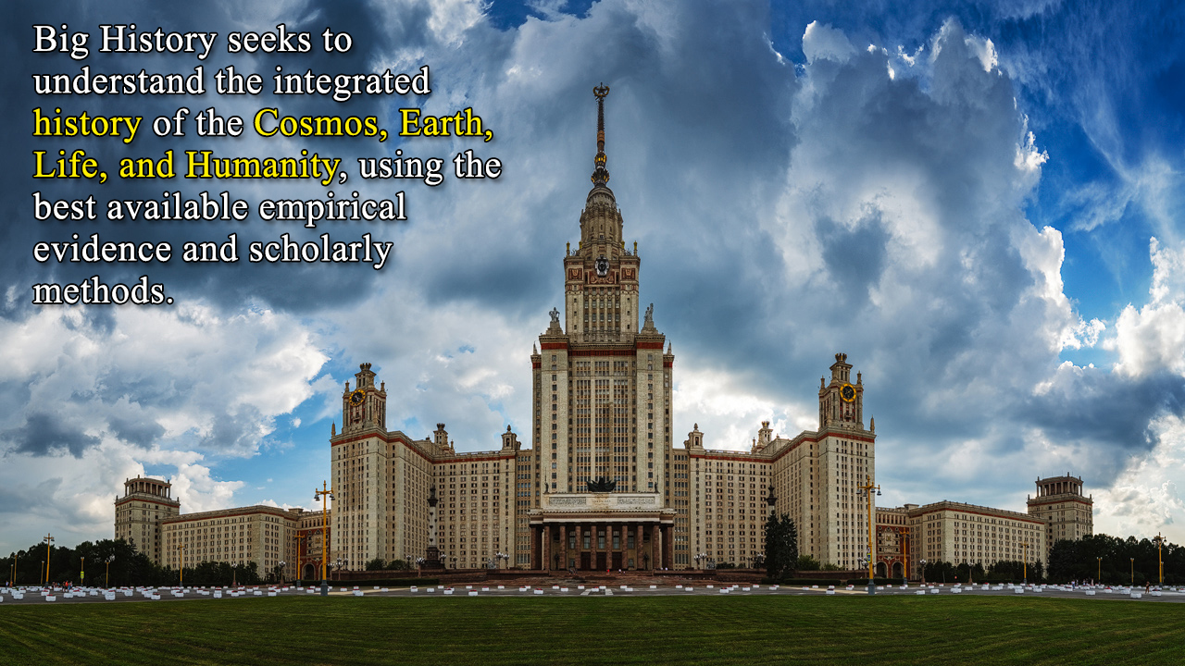
A Bigger Mission for Big History
The current definition of big history made by the IBHA is: “Big History seeks to understand the integrated history of the Cosmos, Earth, Life, and Humanity, using the best available empirical evidence and scholarly methods.” Emergent complexity includes many other planets in addition to Earth. Astrobiology provides reason to expect life on other habitable planets. With that, plus the many other forms of life that are part of our own ecosystem, we see a need to expand the definition of big history. There is not only a single chain of being from big bang to humans. There is a complex emergence in which humanity is embedded. Seeing humanity in splendid isolation or as the single outcome of cosmic development is not only inaccurate; it contributes to our disregard for our ecosystem on which we and other life forms depend.

Slide 3
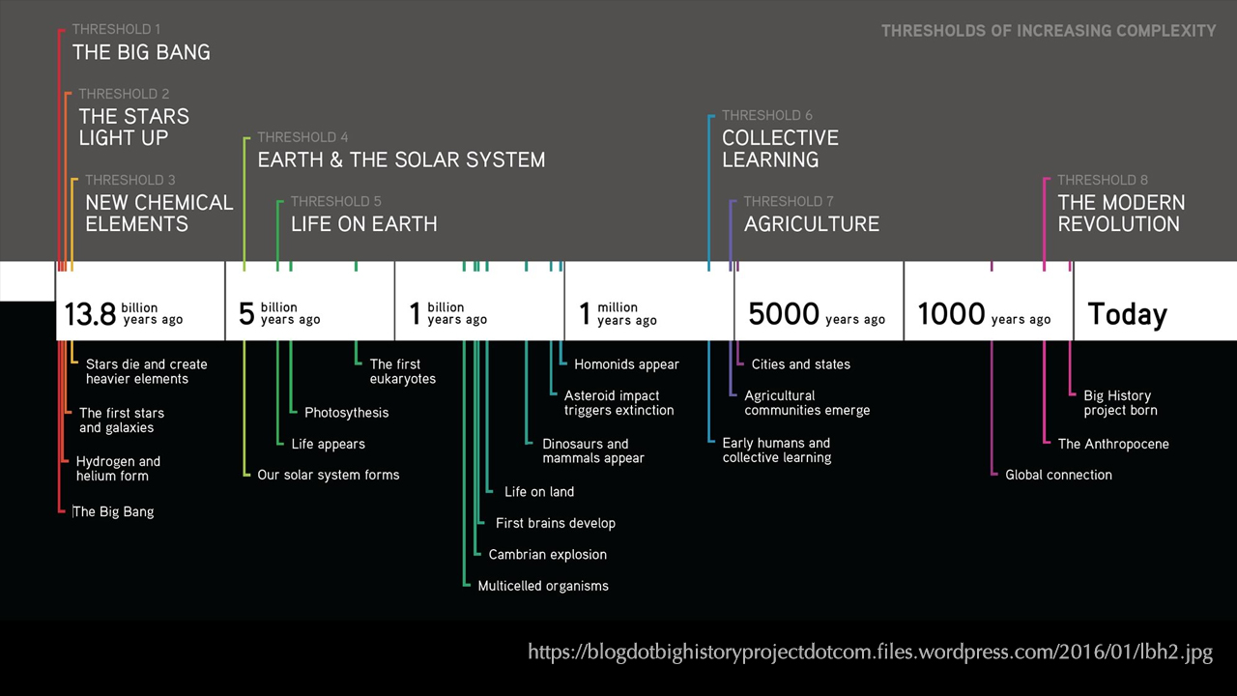

Slide 4
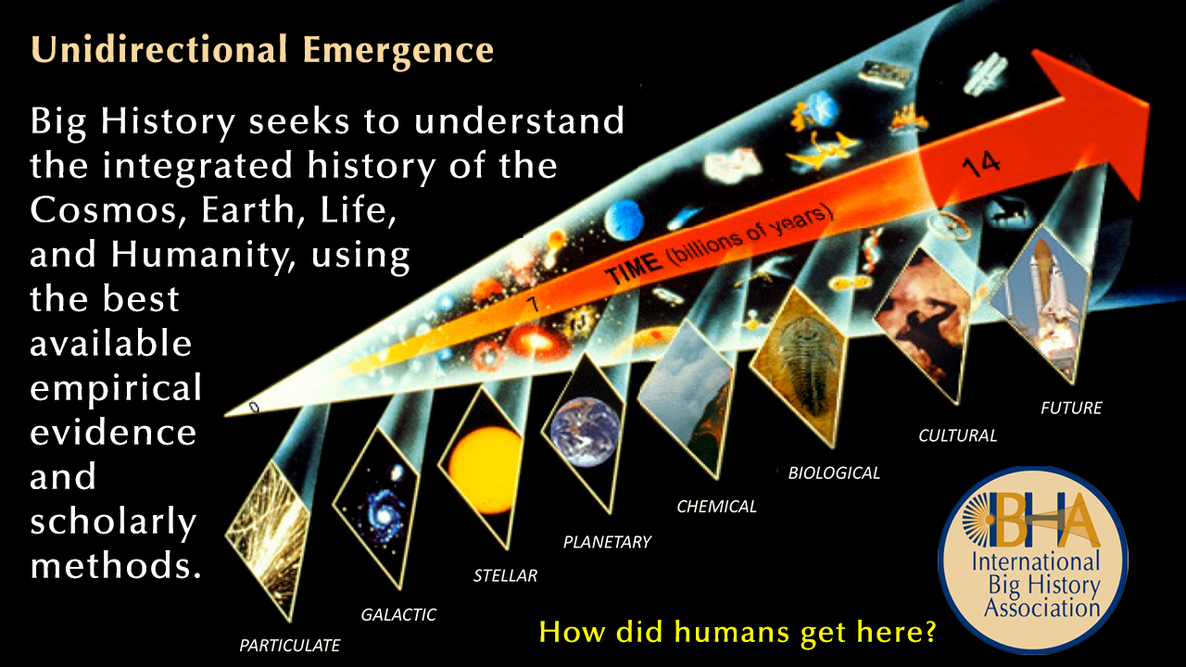

Slide 5
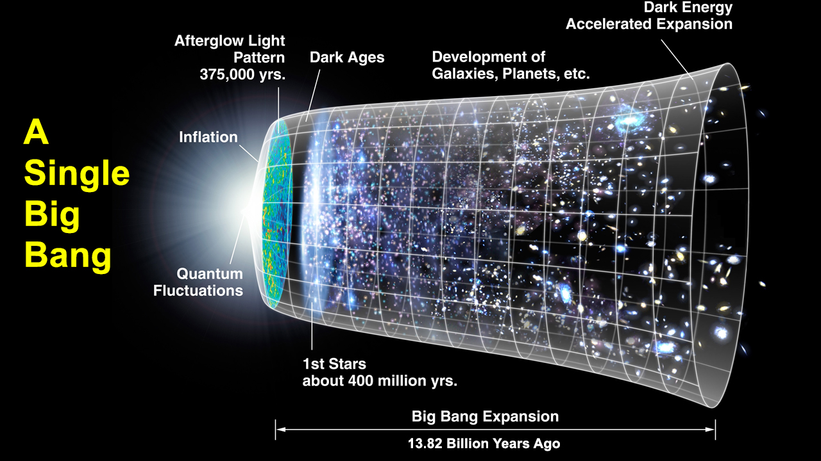

Slide 6
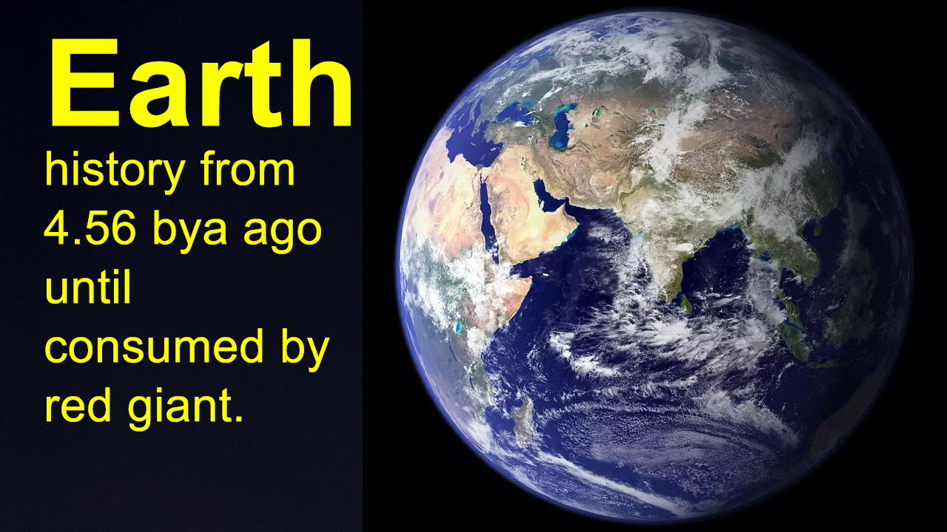

Slide 7
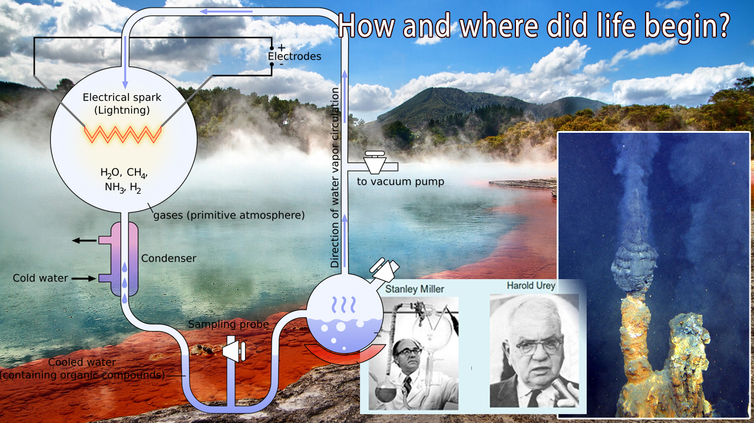

Slide 8
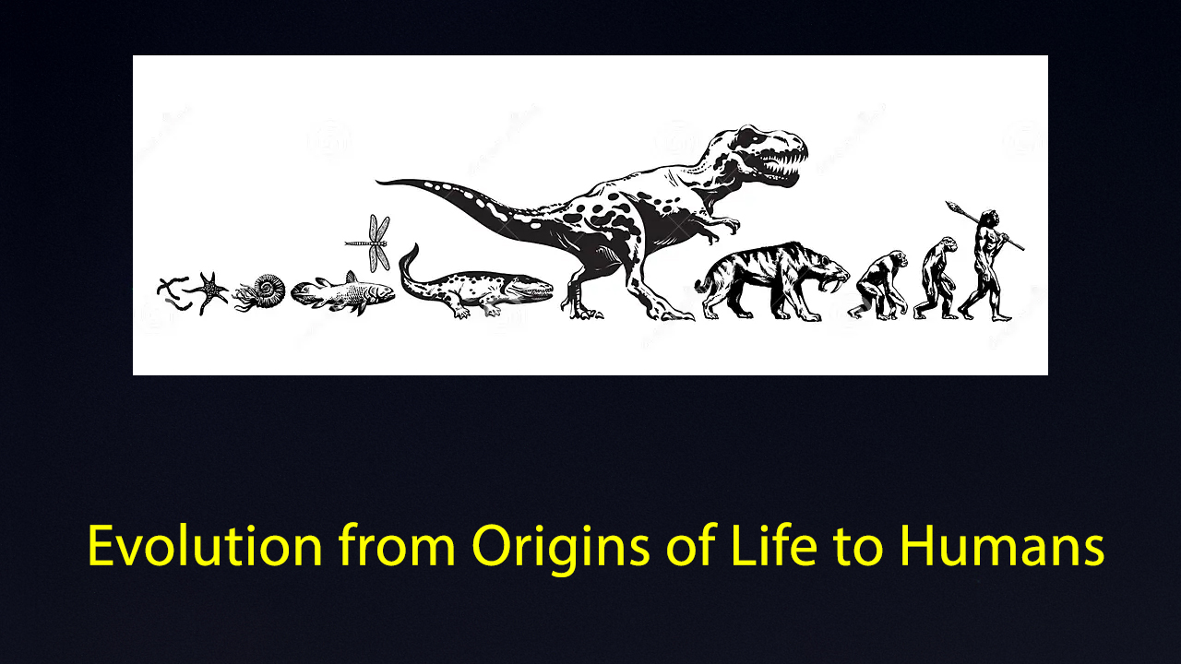

Slide 9
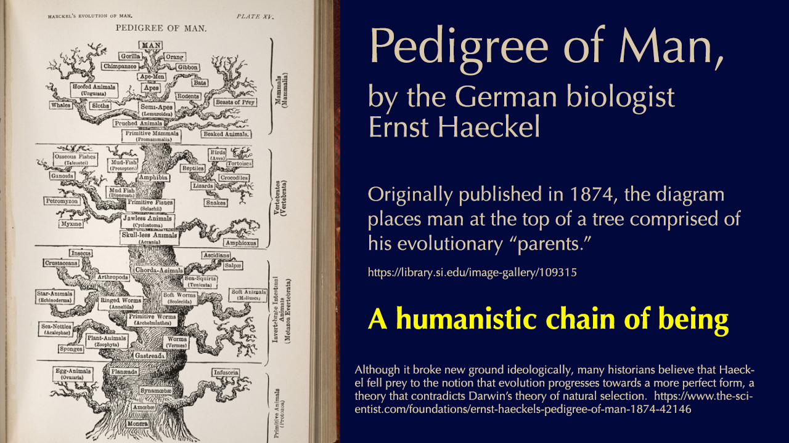

Slide 10
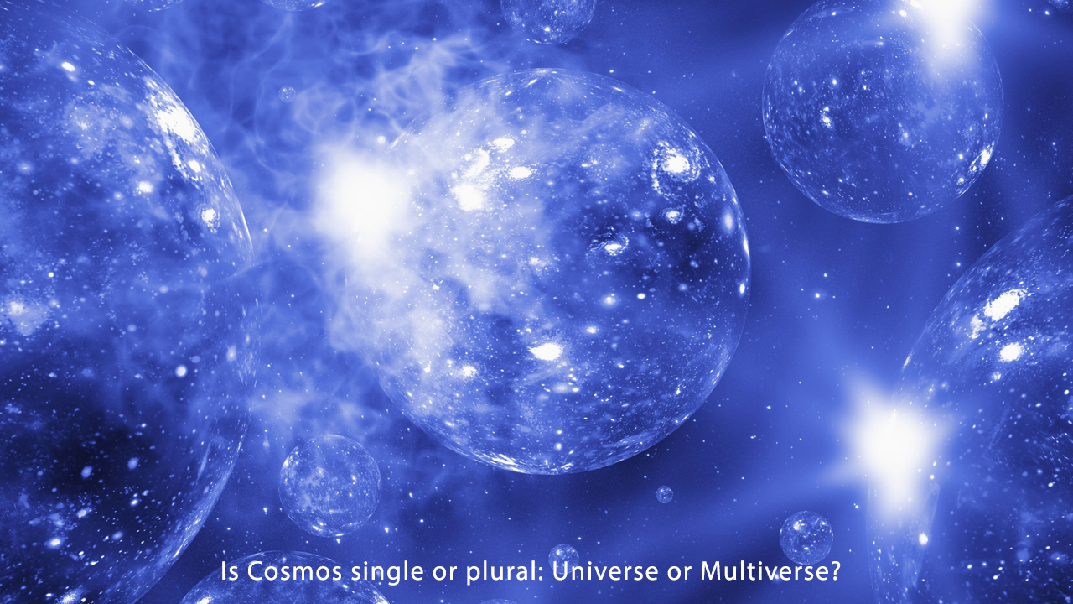

Slide 11
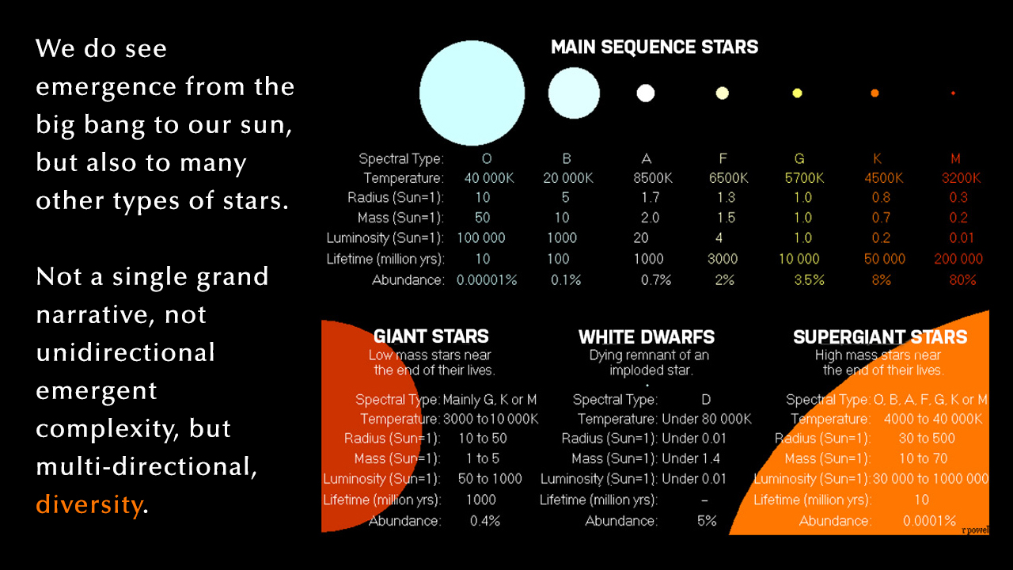

Slide 12
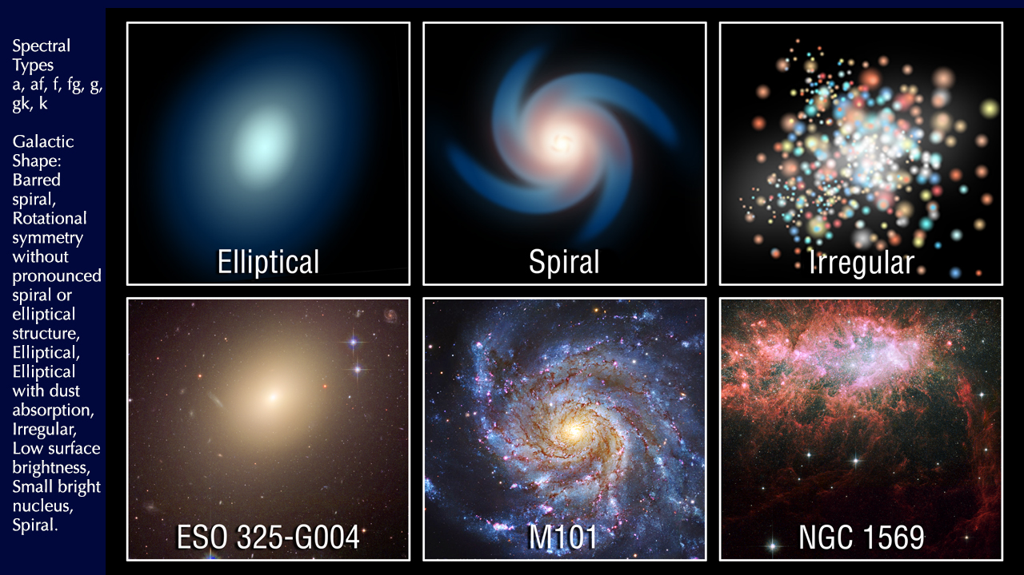

Slide 13


Slide 14
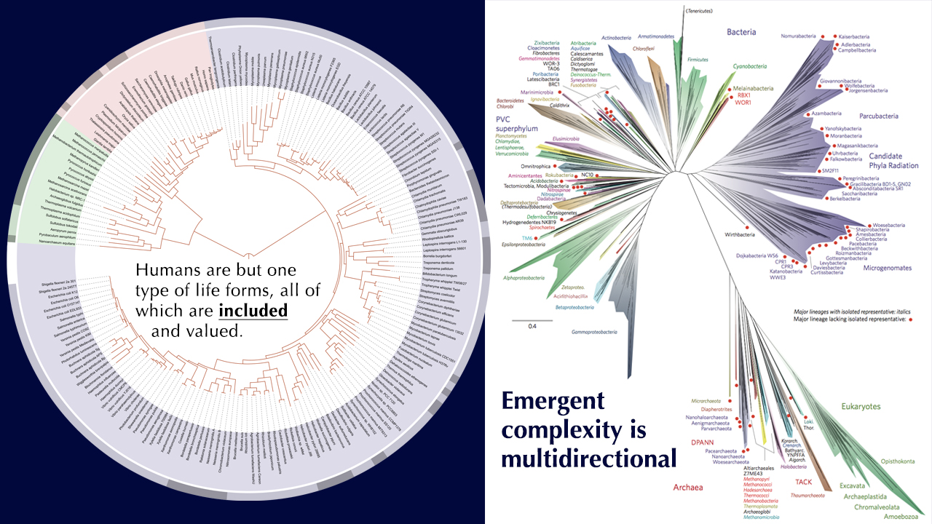

Slide 15
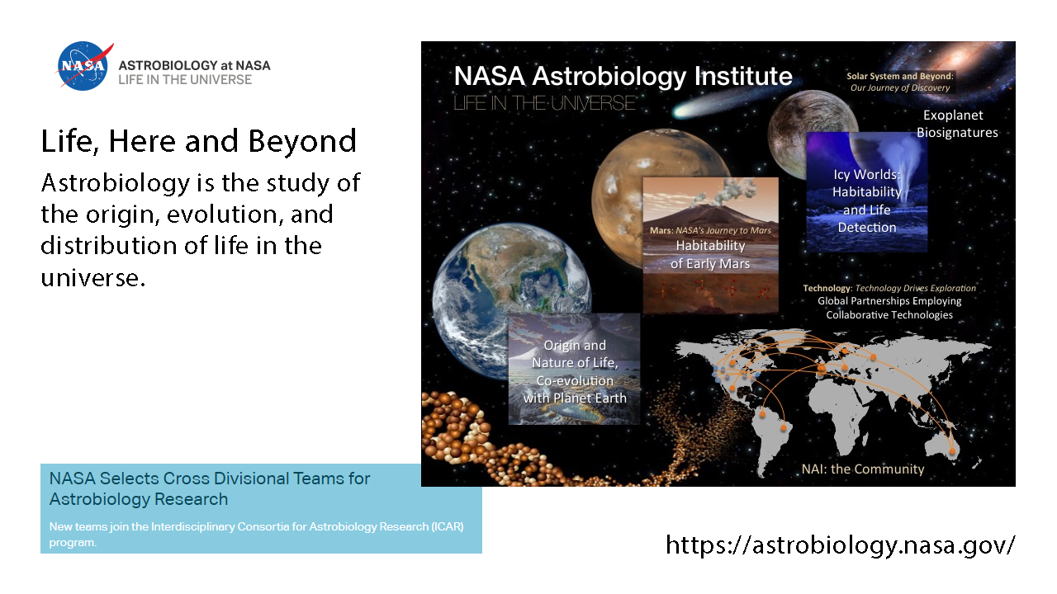

Slide 16
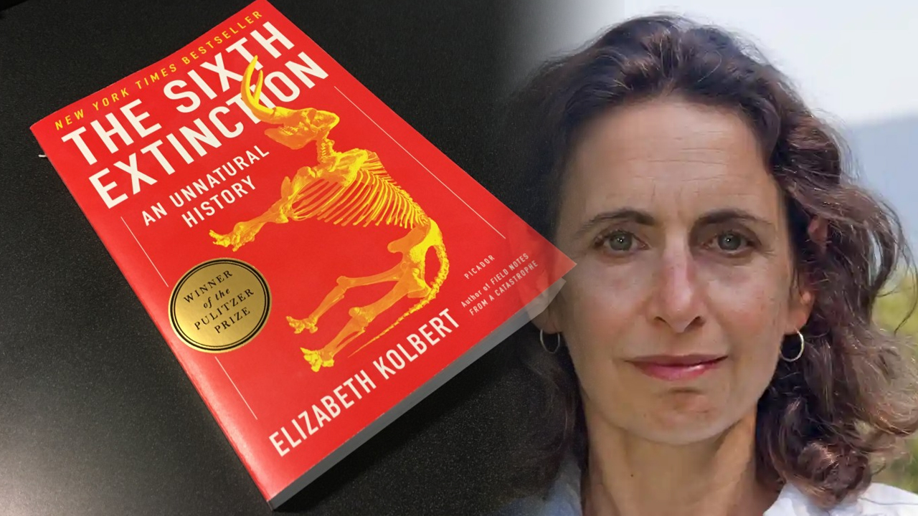

Slide 17
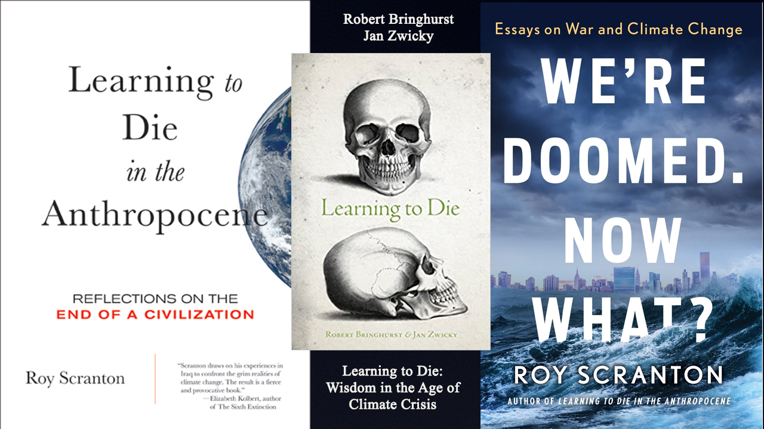

Slide 18
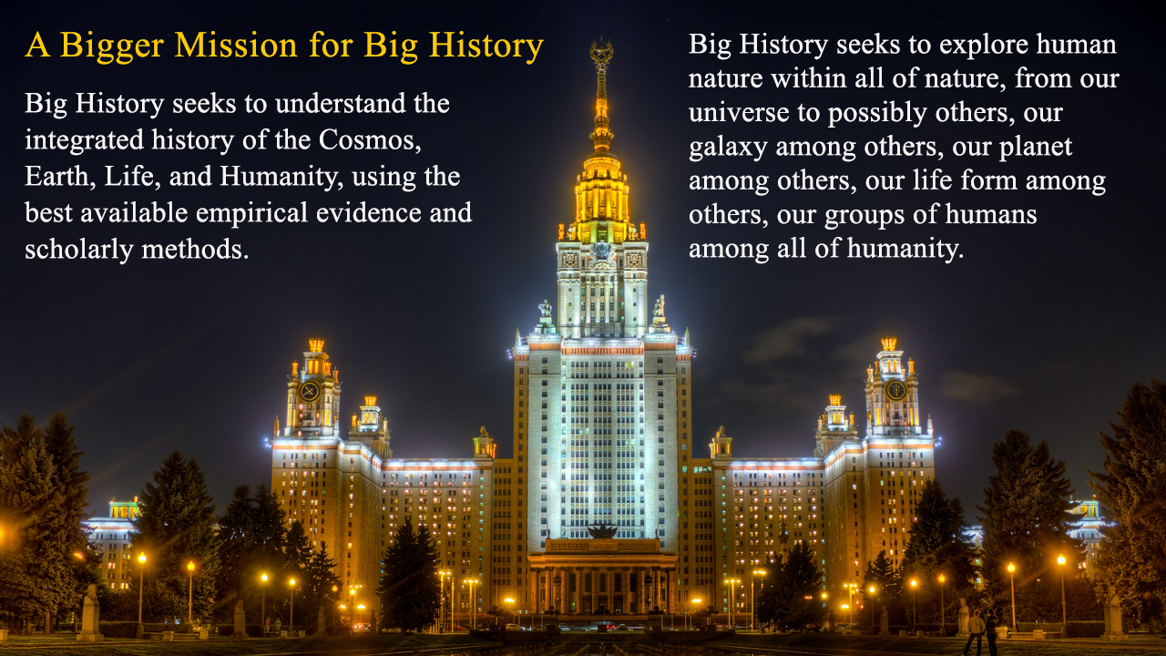

Slide 19
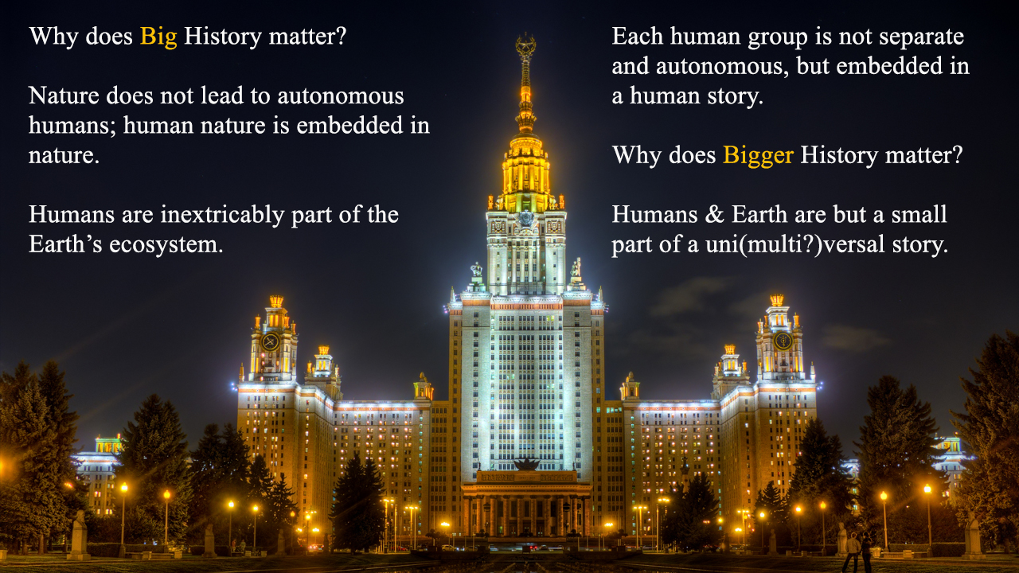
Notes:
Older religious idea: God is beyond, super-natural but in control of nature. Man is in God’s image, and is beyond nature, and in control of it. Hubris has caused the environmental crisis.
Common origins: big bang, LUCA, small band in Africa. First era of globalization is when homo erectus and then homo sapiens migrate beyond Africa.
Individual maturity from realization that many generations came before me, many will come after me. Species maturity likewise.
My personal end is not the end of the story. The end of humanity is not. The end of Earth is not. Still reasons for optimism. There are star nurseries now that are just beginning their life cycles. There may be universal beginnings just getting underway.
We are part of a universal past and perhaps a multiversal present that gives us evidence for endless options. In the short term, that means that the utopians who look for overarching solutions and the reformists who seek to identify the next step forward are as more the realists than those who think we are doomed to repeat the stage of the past to which they are wedded.

