Slide 1


THE FIVE CONTROL STRUCTURES OF SOCIAL HISTORY – AN EVOLUTIONARY TYPOLOGY
László Z. Karvalics
Senior research fellow
Institute of Advanced Studies, Kőszeg

Slide 2

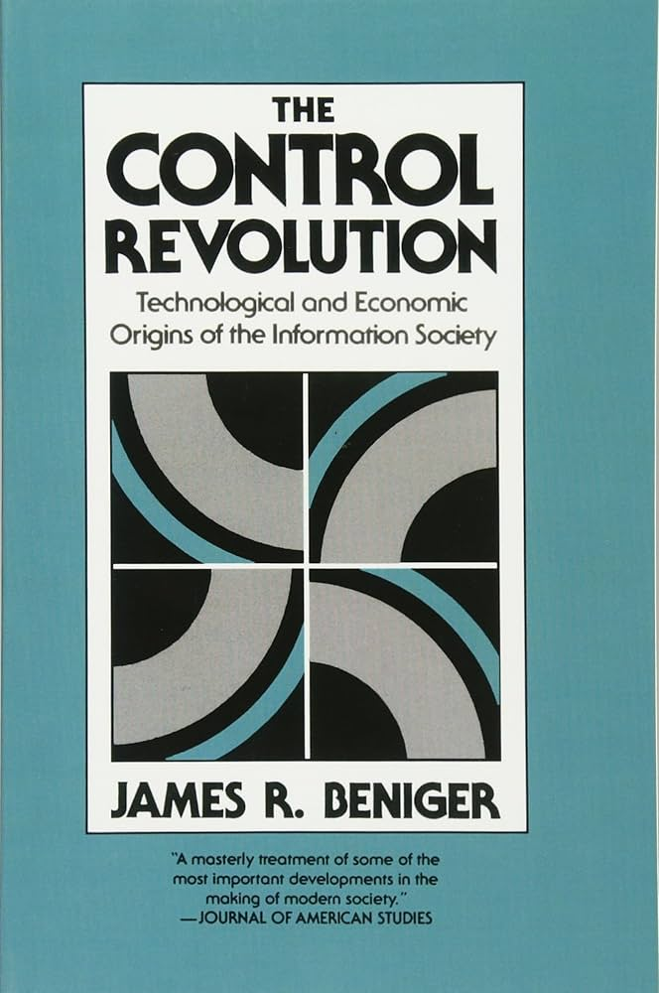
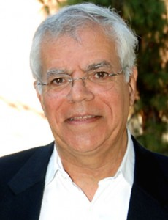
James Beniger and his
Control Revolution (1986)
Information society is a result of a 19th century control revolution.
„A complex of rapid changes in the technological and economic arrangements by which information is collected, stored, processed, and communicated, and through which formal or programmed decisions might effect societal control”
James R. Beniger 1946 -2010

Slide 3
Causal Derivation
Disruptive changes in mass production/manufacturing and distribution/transportation generated by the industrial revolution
Control crisis
Using information technology and capacitive modern institutions to re-create the equilibrium
a Control revolution is taking place – the revolution of bureaucratic control

Slide 4
Beniger as proto-Big Historian
Control defined as „purposive influence toward a predetermined goal” (a kinda’ programming)
(Thermodynamics explains, why) such control is essential to life itself
(„Life itself implies control, after all, in individual cells and organisms no less than in national economies or any other purposive system”)
The model is universal, and valid from the prokaryota - eukaryota transition
Control needs information processing, the history of control crises/control revolution shifts is equal with the history of growing complexity and energy needs of specialized information processing units (from the neural cells to the big organizations)

Slide 5
Problems with the theory
Cybernetic flavor – human/animal control is just a component of a bigger control mix – outer and uncontrollable effects (control mix)
What is the (missing) cause of the great disruption of 19th century?
  Systemic push to a higher level coordination – local actors can optimize their strategies through deeper integratedness into global networks – well-known evolutionary momentum
Crisis-revolution model is insufficient
  we should add „control perturbances – control corrections” understanding the nature of punctuated equilibrium and the stasis-stages
How about the pre-bureaucratic control structures?
How about the crisis of bureaucratic control and the need of the next control revolution?

Slide 6
Hommage to Beniger – and a need for …
A longitudinal/general control theory from the anthropogenesis to the 21st century
Extension of cybernetic concept of control to a generalized set of entangled concepts, reflecting to the complexity of the „space of effects and impacts”
The completion of the control-model with a main evolutionary pattern: the symbiogenetic principle

Slide 7

Big History of human communities from the point of view of symbiogenetic push
Group formation Group transformation
MC as single individual
Multiplication
MC as single individual
INTEGRATION
MC as single individual
Variation
SIZE
COMPLEXITY
threshold
Single Cooperative Multicomponent (MC)
individuals group individual
Control
corrections
Control
Crisis

Slide 8
Starter System level | Group formation stage | Group transformation stage | New system level
Group societies |  |  | Village society
Village societies |  |  | Urban society
Urban societies |  |  | Urban network system
Urban network systems |  |  | Imperial system
Imperial systems |  |  | World Society
World Societies
Isonomic
Hierocratic
Aristocratic
Bureaucratic
Isocratic

Slide 9
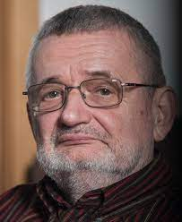
Final comments for Big Historians
Christian: planet forming is also a symbiogenetic step
Control revolution is a rare adaptive event – the number of abortive group tranformations are bigger, the thresholds are merciless, the cultures are inflexible
The only possible way to multiplicate the World Society (as an individual global biocultural system) to create the raw material of future variation and integration – is a cosmic expansion with terraforming (the failure of this mission means an End of Evolutionary system dynamics – Vilmos Csányi: in this case „our whole evolutionary history will be a subchapter of the low temperature physics”

Slide 10
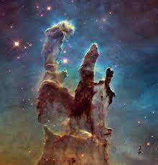
Thank you for your attention!
laszlo.karvalics@iask.hu

