Slide 1
Macroevolution’s Place in Big History
Fifth International Symposium
Big History and Global Evolution
Moscow
24-26 October, 2023
Via Zoom

Slide 2
Macroevolution’s concerns overlap with Big History’s
Macroevolution in evolutionary biology
  Time scale typically upwards of 10s of generations
  Direct observation and experiment generally not possible
  Dependent on biogeochemistry, geology, paleoecology and paleontology
Big History
  All of the above
  Plus evolution of the universe, solar system, planet earth, origin of life, human evolution
  Dependent on history, paleoanthropology

Slide 3
Most interesting questions often macroevolutionary
Is life common in the universe or rare?
Is intelligent life common in the universe or rare?
Why are humans’ big brains and culture a Pleistocene phenomenon?
Why did agriculture begin to evolve 10 kya, not 1 kya or 100 kya?
Why did human populations increase so dramatically in the last 500 years?
When and why did cumulative culture, language, cooperative breeding and other distinctive human traits evolve?

Slide 4
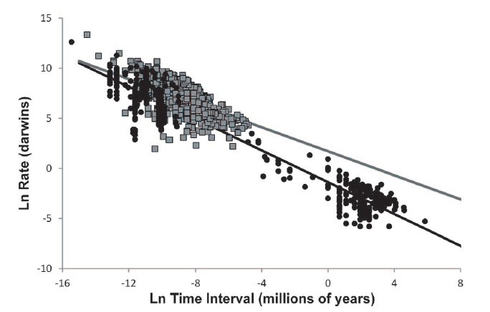
Why can’t we just extrapolate from microevolution to macroevolution?
Evolution has ample reserve horsepower? Jim Valentine
Microbial evolution
time scale
Charles Perreault 2012 PLoS1 (Erhard’s talk on Tuesday)

Slide 5
Tempo, mode, and pattern:
George Gaylord Simpson, 1944
Tempo-the rate(s) of evolution
  Cultural versus genetic
  Variation, strength of selective forces
Mode-the processes driving change
  Selective processes acting on genes or culture
  Random effects
  Gene-culture and other forms of coevolution
Patterns
  Random walks
  Diversification as in adaptive radiations
  Monotonic (progressive) change
  Stasis

Slide 6
Macroevolutionary hypotheses
Internalist
  Tempo and mode regulated by evolutionary processes themselves
  Evolution often imagined to be inherently slow
  Evolution often (controversially) imagined to be progressive, toward greater complexity for example
  Example: evolution of stars rather deterministically internal
Externalist
  Evolutionary patterns a response to selection in environments of the relatively recent past
  Evolution potentially fast on the geological time scale
  Macro patterns thus reflect environmental patterns
Pre-adaptationist
  When environments change some have existing characters that can be readily adapted
  Those without pre-adaptations go extinct
Sun’s talk yesterday

Slide 7
Debates go back a long way
Darwin (largely externalist, particularist, non-progressivist) versus Spencer (largely internalist, progressivist)
Franz Boas (historical particularist) versus Leslie White (material progressivist)
Human case

Slide 8
Examples: human origins macro questions
Why did humans evolve in the Pleistocene?
Why didn’t other species evolve a very high dependence on cultural adaptations?
Why did it take the whole Pleistocene, not more, not less, for Homo sapiens to evolve?
What explains the progressive cultural evolutionary trend in the Holocene?

Slide 9
Internalist explanations common
Old progressivist ideas (Haeckel’s tree of evolution)
Trigger + positive feedback proposals (progressivist)
  Free hands (Washburn 1959)
  Language (Maynard Smith and Szathmary 1995)
  Cooperative breeding (Hrdy 2009, Isler and van Schaik 2009)
  Cooking (Wrangham 2009)
At short enough time scales the maximum rate of evolution must be limiting
  But Gingerich-Perreault curves suggest much reserve adaptive capacity thus perhaps mainly external regulation of evolutionary patterns on geological time scale
  Holocene progressive evolution quasi-experiment

Slide 10
Plenty of grist for externalist environment driven hypotheses

Slide 11
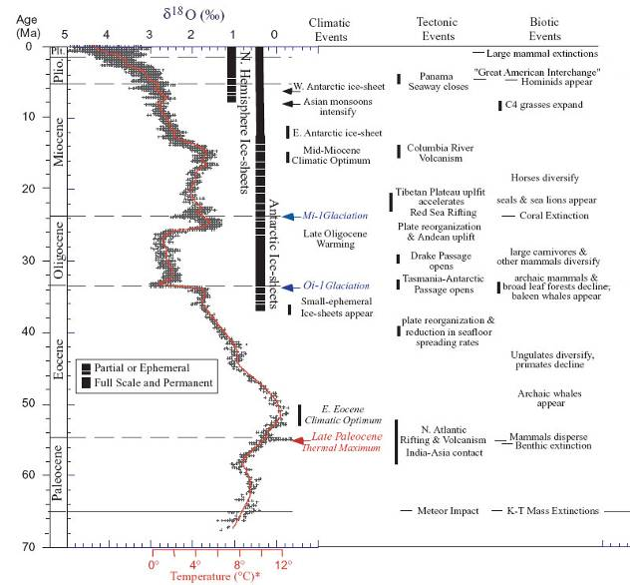
Climate variation in space and time
Mammalian
Brain size increase
Jerison 1973
Zachos et al 2001 Science

Slide 12
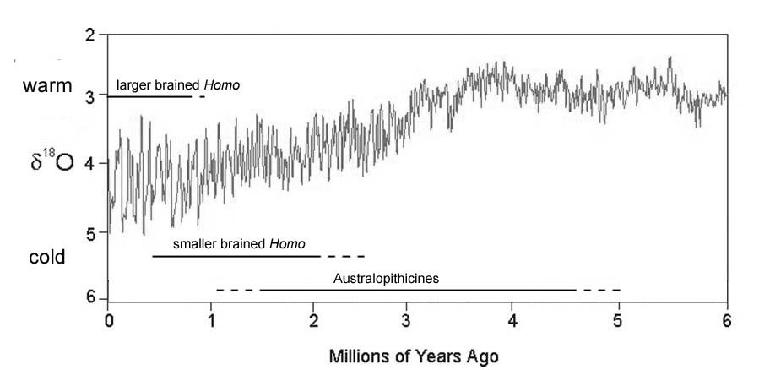
Hominins’ very big brains evolved during the Plio-Pleistocene increase in climate variation
First stone tools

Slide 13
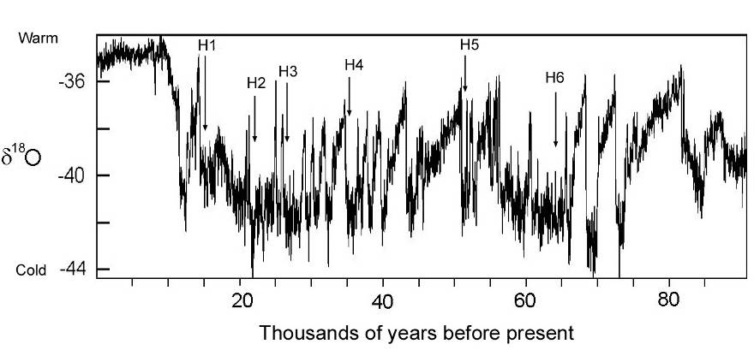
Millennial and sub-millennial scale variation from Greenland GRIP core
Ditlevsen et al. 1993
Rob Boyd and I (1985) argued that high amplitude millennial and submillennial scale variation like this could support a costly culture adaptive system.

Slide 14
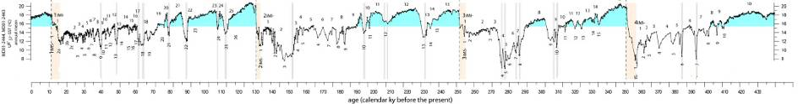
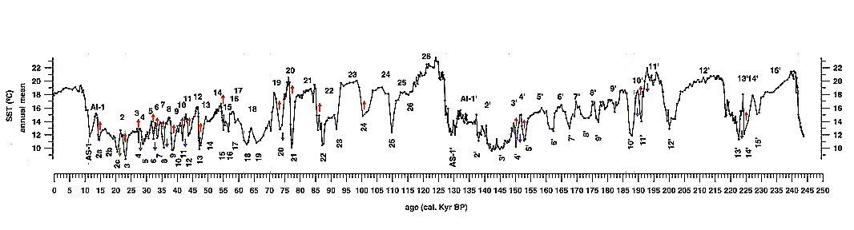
Ongoing increases in millennial and sub-millennial scale variation
Mode 4 or 4ish stone tools
Agriculture
Big brained hominids
Martrat et al. Science 2007
Martrat et al. 2004
Notes:
14

Slide 15
Brain size and abrupt climate change

Slide 16
Ape pre-adaptations for cultural niche:
Surpassing the gray ceiling
Apes have big brains
  Good social learners
Apes are social
  Groups as cultural reservoirs
  Moderately cooperative
Apes have grasping hands
  For tool use
Australopiths: Free hands as preadaptation for technology
Technology and cooperation eventually pay the overhead for our huge, expensive brains

Slide 17
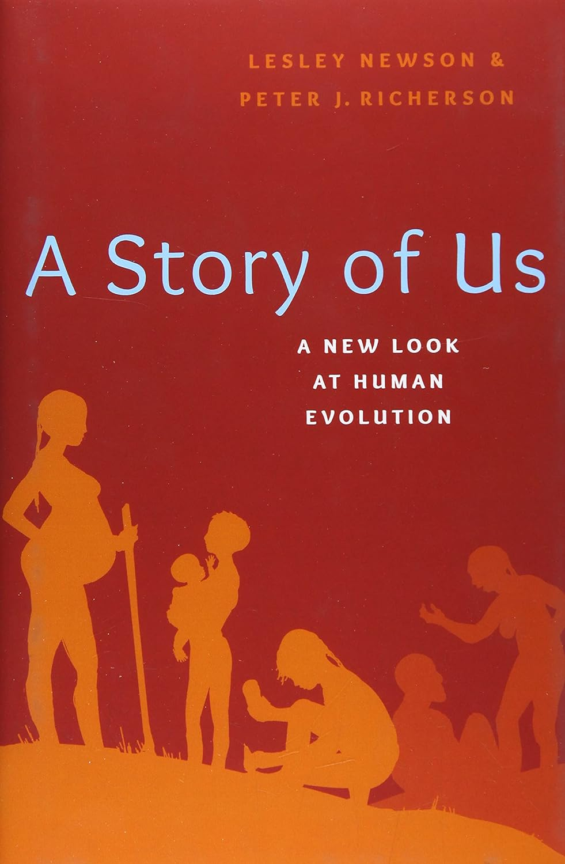
More on cultural evolution and human macroevolution

Slide 18
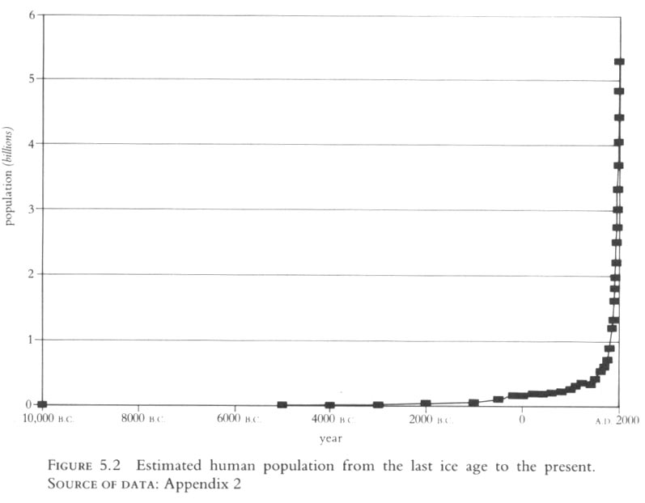
Cumulative evolution in the Holocene slow then explosive:
Fairly fast hyper-exponential progressive trend
Temporal environmental modest, mostly agricultural adaptive radiation to spatial variation
Korotayev A, Malkov A, Khalttourina D. Introduction to Social Macrodynamics: Compact Macromodels of the World System Growth. Moscow: Editorial URSS; 2006. 128 p.
Joel Cohen 1995

Slide 19
Charles Efferson’s ecology inspired models
Commonest results of simulations a “post human equilibrium”
Charles Efferson, Peter J. Richerson and Vanessa Weinberg. In press. Our fragile future under the cumulative cultural evolution of two technologies. Philosophical Transactions Royal Society.
Russell Genet, Peter Richerson, Cheryl Genet, and Charles Efferson. Dynamic models of human systems: How they help us explain our past and manage our future. https://learn.culturalevolutionsociety.org/human_systems_module/ See models 3 and 5

Slide 20
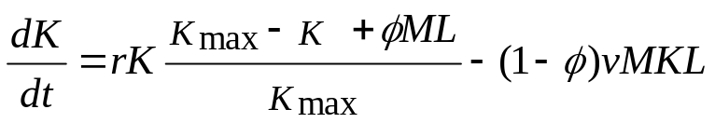
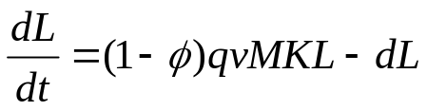
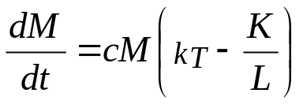
Charles Efferson’s model of an agricultural system
Farmed crop, herded livestock or agroecosystem (kapital)
r = intrinsic rate of increase of agroecosystem
K = biomass of agroecosystem
K_{max} = “carrying capacity” of agroecosystem
v = offtake coefficient
Φ = investment parameter
L = farmers
q = conversion efficiency
d = death rate of farmers
M = technology
c = per capita innovation rate
k_{T} = threshold for innovation to be +
Farmers (labor)
Technology (tools or social system)

Slide 21
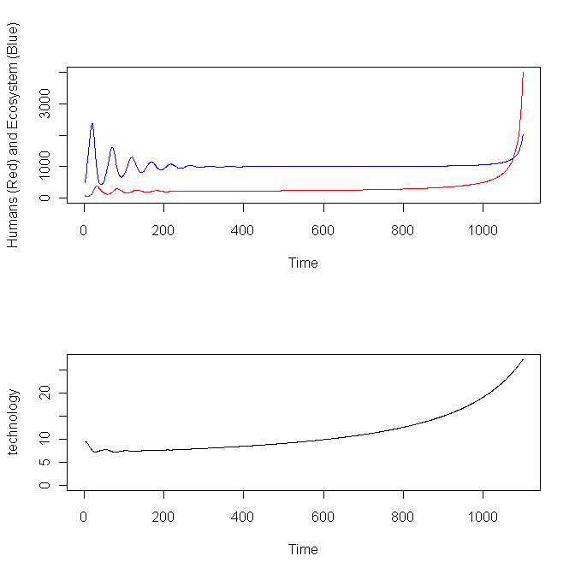
Can mimic the Holocene with a simple model with Tasmanian Effect feedback
r = .2 # intrinsic rate of increase of prey/ecosystem
K.max = 5000 # Carrying capacity of prey/ecosystem in absence of investment
phi = .9 # Human investment intensity in prey/ecosystem
v = .1 # v =biomass offtake coefficient from prey/ecosystem
q = .1 # q = biomass increment to humans per unit offtake from prey/ecosystem
d = .1 # Death rate of humans
c.4 = .001 # Intrinsic rate of technology growth
k.T = 5 # Threshold ratio of K/L below which growth of technology is positive
# Starting values
K = 500
M = 9.5
L = 75
n.steps = 1100 # the number of time steps to run

Slide 22
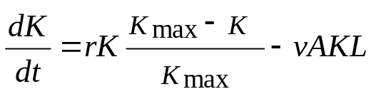
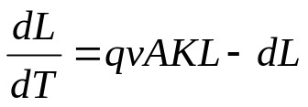
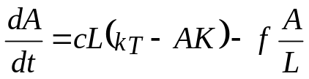
Charles Efferson’s model of hunter-gatherer system
Prey (renewable resource, exploited ecosystem) equation
r = intrinsic rate of increase of prey
K = abundance prey
K_{max} = carrying capacity of prey
v = offtake coefficient
L = human abundance
q = conversion efficiency
d = death rate of H-Gs
A = quality of technology
c = per capita innovation rate
k_{T} = threshold for innovation to be +
f = loss rate factor for technology
Hunter-gatherer (labor) equation
Technology equation

Slide 23
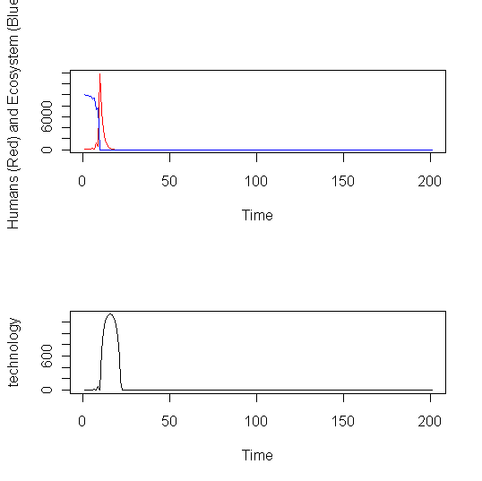
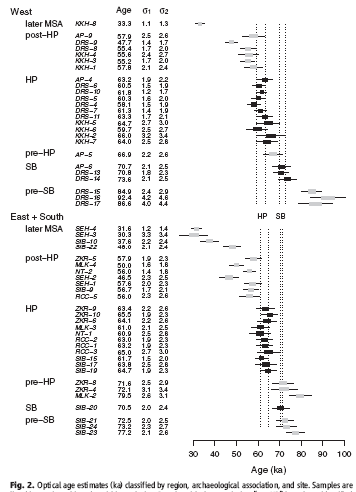
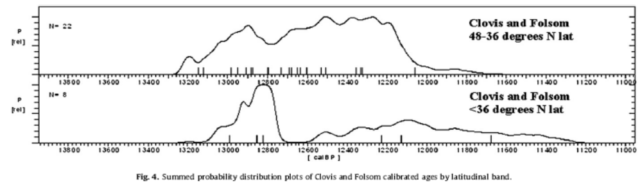
For some resources like climate we still behave like H-G
# Initialize Parameters
r = .2 # intrinsic rate of increase of prey/ecosystem
K.max = 10000 # Carrying capacity of prey/ecosystem
v = .0001 # v =biomass offtake coefficient from prey/ecosystem
q = .5 # qv = biomass increment to humans per unit offtake
d = .5 # Death rate of humans
f = 5 #Technology loss term
c.8 = .005 # Intrinsic rate of innovation per capita
k.T = 10 # Threshold effective prey return rate
# Starting values
K = 10000
A = 1
L = 100
Sometimes superpredators crash the whole system
Collard et al. 2010
Jacobs et al. Science 2008

Slide 24
Conclusions
Macroevolution not a simple extrapolation from microevolution
If adaptive processes powerful at the macro time scale internalist/progressivist hypotheses questionable
Preadaptation a potentially important explanation
External environmental variation plausibly played strong roles
Complex dynamics (cycles, chaos) may play an important role (neither human subsistence system has a stable equilibrium)
Big History will have to deal with these issues
END: Thanks for your ears!

